Slide 1
Research Updates on GNN Species Discovery
Rui Xu
University of Southern California
May 6, 2026

Slide 2
Research objectives
Objectives
Develop a graph network generation approach that allows GNN to self grow, evolve, and prune
Study network behavior during the GNN growth process
Study/Test systems
H/O system:
H₂-O₂ oxidation: simplest reaction network for GNN development and tests
H/O/C system:
CH₄/C₂H₄/C₂H₆-O₂ oxidation: small hydrocarbon reaction networks
C₄H₆-O₂ oxidation: less-resolved reaction network; relevant to modern solid fuel combustion
H/O/C/N system:
Reactions are relevant to modern solid fuels and explosive chemistry, e.g., HTPB/AP combustion
We can build the network following two general steps:
Step 1: NH₃-O₂ reaction network
Step 2: Hydrocarbon-N-O reaction network

Slide 3
Current research task
Atom-based GNNs with species identifications
Use the existence of species inside given chemical kinetic models to train GNN
GNN evolves to self-grow and prune atomic nodes and bond edges
Two research directions are proposed:
Direction 1: Minimum-unit growing GNN
Direction 2: Multiple-node classification GNN
Will start with the H/O (H₂-O₂) system and a four-node, minimum-unit GNN configuration.

Slide 4
Two research directions
Direction/Idea 1: Minimum-unit growing GNN
GNN grows in iterations by a minimum unit set of atom nodes (e.g., for H/O system, a minimum unit can be 2H + 2O atom nodes)
GNN is trained using the existence of species from literature kinetic model
Direction/Idea 2: Multiple-node classification GNN
GNN performs classification task to identify species
GNN is initiated with multiple atom nodes at O(10) size (e.g., for H/O system, about 50 H and 50 O atom nodes are initiated)
GNN is trained using using the existence of species from literature kinetic model
…
…
…
…

Slide 5












Starting point – The four-node minimum unit
We started training a four-node minimum growing unit system as a starting point.
Define the minimum growing unit as 2 H atom nodes and 2 O atom nodes, and initialize them
Nodes with the same elements are permutationally invariant
GNN training follows a two-step procedure presented below
Embeddings (inputs)
Step 1
GNN message passing
Step 2
MLP training for outputs
MLP: Multilayer perceptron
(i.e., Neural network)
$x_{i}$: Atomic number
$d_{ij}$: Interatomic distances
Training outputs:
Node: existence probability in a species
Edge: bond order
$$x_{1}$$
$$d_{14}$$
$$x_{4}$$
H
O
$$d_{12}$$
$$d_{13}$$
$$d_{34}$$
$$d_{24}$$
Training data:
Existence of species in given chemical kinetic models
Species bond length vs. bond order data from chemistry database
H
$$x_{2}$$
$$d_{23}$$
O
$$x_{3}$$

Slide 6
























GNN architecture breakdown
Step 1: Message passing
Example of Node 1 message passing
$$x_{1}$$
$$d_{14}$$
$$x_{4}$$
$$x_{1}$$
H
O
$$m_{41}$$
$$x_{4}$$
$$h_{1}$$
$$x_{4}$$
H
O
H
O
$h_{1} [64×1]$
$$d_{12}$$
$$d_{13}$$
$$d_{34}$$
$$m_{21}$$
$$m_{31}$$
$$d_{24}$$
H
H
H
$$x_{2}$$
$$d_{23}$$
O
O
$$x_{2}$$
$$x_{2}$$
O
$$x_{3}$$
$$x_{3}$$
$$x_{3}$$
$$m_{ji}=e^{−{2d}_{ji}}∙x_{j}$$
Embeddings (inputs)
$$h_{i}=Mean(m_{ji})$$
$x_{i}$: Atomic number
Atom/Node $i$ (i.e., 1) receives messages ($m_{ji}$) from its neighboring nodes $j$ (i.e., 2, 3, 4)
An aggregate vector, $h_{i}$ is calculated by taking the mean messages from its neighboring nodes
$d_{ij}$: Interatomic distances

Slide 7










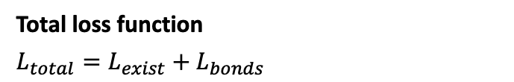

GNN architecture breakdown
Step 2: MLP predictor for atom existence and bond orders
Node Existence Predictor
Node input:
Total loss function
$$L_{total}=L_{exist}+L_{bonds}$$
$h_{i} [64×1]$
…
…
1
Output
where
$$p_{i, GNN}$$
$$L_{exist}=λ_{exist}∙BCE\left(p_{i, GNN},p_{i, true}\right)$$
32
Hidden
$$p_{i, GNN}$$
$h_{i} [64×1]$
64
Input
p: probability of a node i within a species
$$L_{bonds}=λ_{bond}∙MSE\left({BO}_{ij,GNN},{BO}_{ij,true}\right)$$
Bond
Order
Predictor
Edge input:
BO: bond order of the i-j pair
$h_{i}+h_{j} [64×1]$
for now, the weights of loss are 1 to 1 ratio:
Node aggregates
from Step 1
$${BO}_{ij,GNN}$$
$\left|h_{i}−h_{j}\right| [64×1]$
…
…
$$λ_{bond}:λ_{bond}=1:1$$
…
$h_{i}∙h_{j} [64×1]$
1
$${BO}_{ij,GNN}$$
$d_{ij} [1×1]$
32
193
64

Slide 8
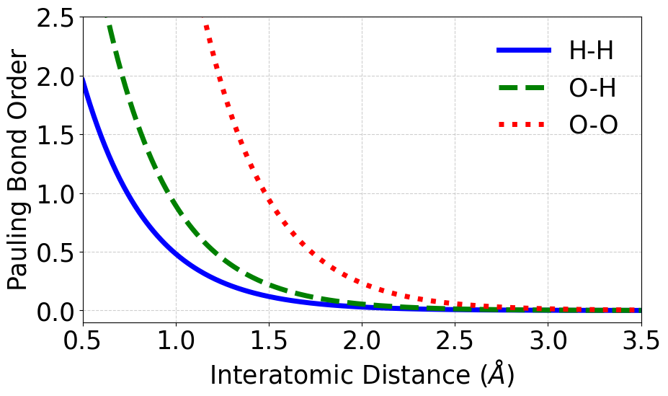
Training data
Types of the training data
Graphs with variations in interatomic distances generated randomly.
Existing species of H/O system are: H₂, O₂, H, O, OH, H₂O, HO₂, & H₂O₂.
The bond order information of the existing species will be estimated based on their inter-node distances (e.g., using Pauling bond order estimation).
Atom node
Example training graphs
Possible bond edge (positive link)
Not a bond edge (negative link)
H
H
O
H
O
H
H
O
O
O
H
O
O
H
O
H
O
O
H
H
Possible species: H₂, O₂
Possible species: OH, H, O
Possible species: H₂O, O
Possible species: H₂O₂
Possible species: HO₂, H

Slide 9
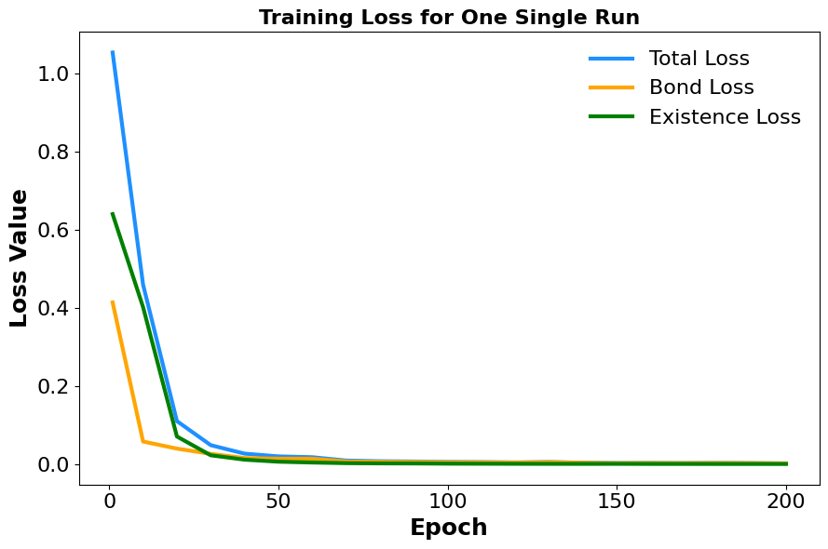
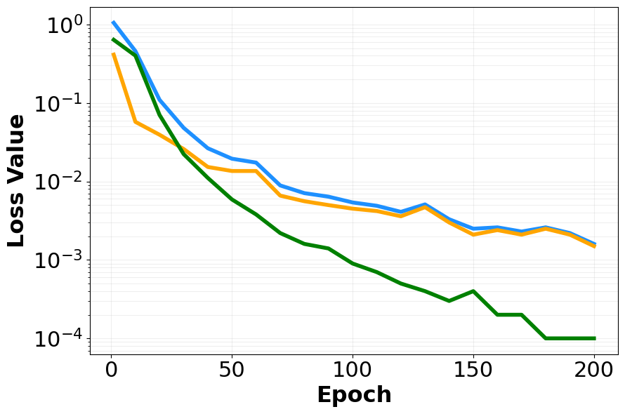
Training loss example
Trained on 1000 H/O four-node data
y-log scale

Slide 10
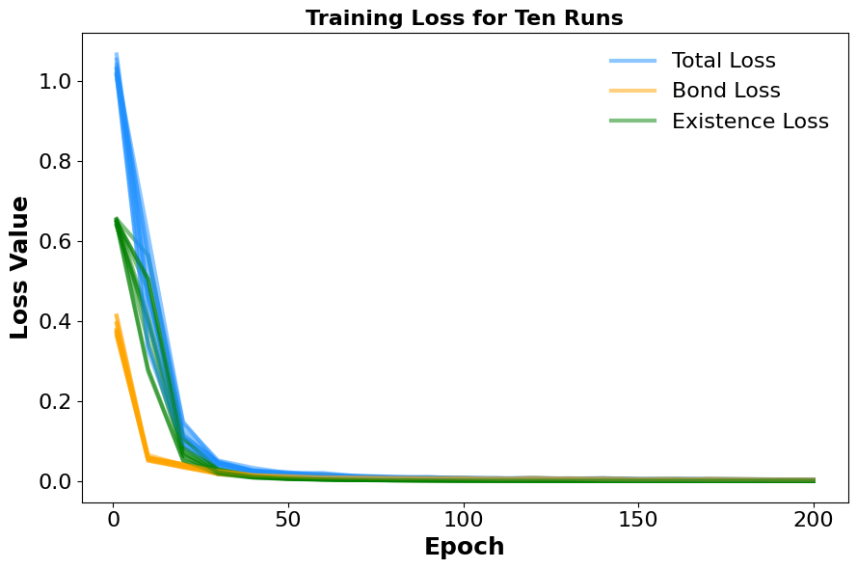
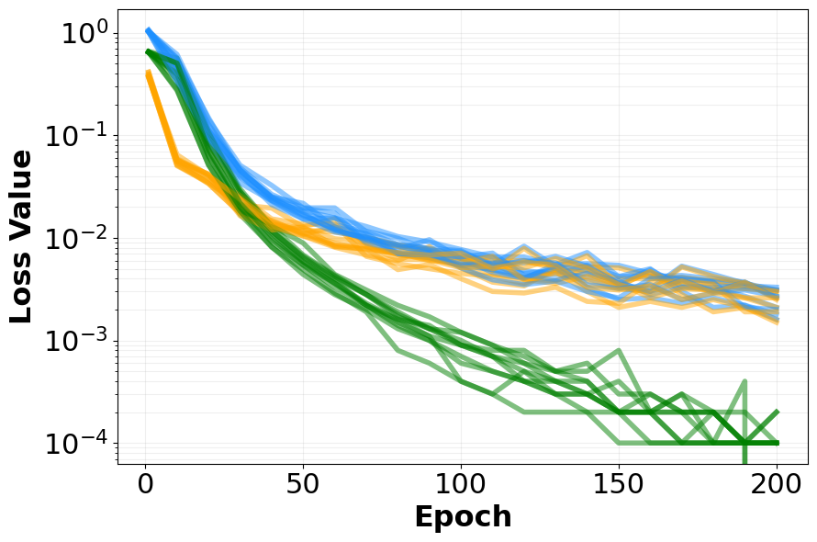
Training loss – Ten runs (robustness test)
y-log scale

Slide 11
Test results – H₂ + O₂
A satisfactory test on
one H₂ molecule and one O₂ molecule at their minimum-energy bond lengths
(i.e., H–H: 0.74 Å, O–O: 1.21 Å)
All the ten trained 4-node GNN models were tested on all the H/O species with variations on the interatomic distances.
The test species are: H₂, O₂, H, O, OH, H₂O, HO₂, & H₂O₂.
Model predictions on bond order and atom existence probability were tested against a variety of 4-node graph structures.
Edge thickness scales with the bond order
Bond order value
Probability of a node/atom existing in a species

Slide 12
Test results – H₂ + O + O
H₂ molecule with a stretched H–H bond, i.e., at 1.64 Å.
H₂ molecule at its equilibrium structure
Weak bond order
Existence probability much lower than 1.0, meaning a possibility of radical formation

Slide 13
Test results – O₂ + H + H
O₂ molecule with a stretched O–O bond, i.e., at 1.66 Å.
O₂ molecule at its equilibrium structure

Slide 14
Test results – H₂O + O
H₂O molecule at its equilibrium structure
H₂O molecule with a stretched O–H bond
Stretched O–H bond: 1.76 Å.
Interesting observation: H atoms in water are barely interacting…

Slide 15
Test results – HO₂ + H
HO₂ radical at its equilibrium structure
HO₂ radical with a stretched O–O bond
Stretched O–O bond: 1.66 Å.

Slide 16
Test results – H₂O₂
H₂O₂ at its equilibrium structure
H₂O₂ with a stretched O–O bond

Slide 17
Test results – OH + OH and OH + O + H
Interesting observation:
Different existence probabilities in H and O may signal different reactivity.
Two OH radicals at their equilibrium structures
One OH radical at its equilibrium structures
A stretched O–H bond

Slide 18
Test results – OH + OH and OH + O + H
Four radicals far apart from each other
Four radicals approaching to each other
Four radicals getting even closer

Slide 19
Next steps – Direction 1: Minimum-unit evolution GNN
Evolution of the GNN
With the trained 4-node model, the GNN should process “knowledge” to infer a possible set of species from a given a four-node (2H+2O) configuration.
In the next iteration, a new set of minimum growing unit (2H + 2O nodes) will be added to the graph.
Ideally, the new GNN (i.e., with 4H + 4O nodes) does not need additional trainings, since the Iteration-1, 4-node GNN already has information about “all” species involved in the H/O system.
The GNN will evolve through iterations and converge when all the species are discovered.
Adding the minimum growing unit
Iteration 1
Iteration 2
H
O
H
O
H
O
H
O
…
H
O
H
H
O
H
Possible species: H₂, O₂
O
O
Possible species: H₂, HO₂, OH, O
Atom node
Possible bond edge (positive link)
Undetermined edge
Not a bond edge (negative link)

Slide 20
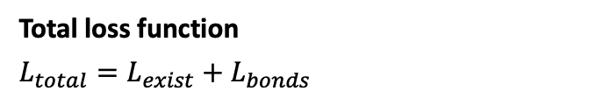
Direction 2 – Multi-node classification GNN
Example: H/O system
Initially populate multiple nodes of H atoms and O atoms. For example, 50 H atoms and 50 O atoms.
Same training data, loss function, and training outputs as in Direction 1.
…
Embedding features (inputs)
Training data:
Existence of species in given chemical kinetic models
Species bond length vs. bond order data from chemistry database
O
Atom node embeddings
Atomic number
Valence electrons
Electronegativity
Spin multiplicity
O
O
H
Training outputs:
Node: existence probability in a species
Edge: bond order
H
O
H
H
O
Total loss function
$$L_{total}=L_{exist}+L_{bonds}$$
O
O
H
O
where
H
H
Bond edge embeddings
Interatomic distance
H
…
$$L_{exist}=λ_{exist}∙BCE\left(p_{i, GNN},p_{i, true}\right)$$
p: probability of a node i within a species
Note: The GNN is supposed to be fully connected. Not all the edges are displayed simply for visualization purpose.
$$L_{bonds}=λ_{bond}∙MSE\left({BO}_{j,GNN},{BO}_{j,true}\right)$$
BO: bond order of the j^{th} pair

Slide 21
Direction 2 – More on training data
Types of the training data (same as in Direction 1 but with larger graph sizes)
Graphs with variations in inter-node distances (interatomic distances) generated randomly.
Existing species of H/O system can be obtained from chemical kinetic models, e.g., FFCM-2.
The bond order information of the existing species will be estimated based on their inter-node distances (e.g., using Pauling bond order formula).
Example training graph data
O
O
O
O
O
O
O
O
O
Atom node
H
H
H
H
H
Possible bond edge
(positive link)
O
H
H
H
H
O
H
O
H
O
Not a bond edge
(negative link)
H
O
O
H
O
O
O
O
Note: The GNN is supposed to be fully connected. Not all the edges are displayed simply for visualization purpose.
O
O
H
O
H
O
H
H
O
H
H
H
H
H
H
…
…
H
…
Possible species:
O₂, 2OH, H₂O, HO₂, H₂, H, O, & etc.
Possible species:
H₂O₂, 2OH, H₂, HO₂, H, 2O, & etc.
Possible species:
2HO₂, 2OH, 2H₂, O₂, & etc.

